Slide 1
A Statistical Algorithm for Linguistic Steganography Detection Based on Distribution of Words
Bộ môn Khoa Học Máy Tính
Khoa Công Nghệ Thông Tin
Nguyễn Xuân Huy - 0712196
Trần Văn Tiến - 0712446

Slide 2
Mindmap

Slide 3
Nội dung
Bài toán nhận biết dữ liệu ẩn
Sự khác biệt từ
Support Vector Machine
Báo cáo kết quả

Slide 4
Linguistic Steganography Detection

Slide 5
Steganography Method
Steganography Method
NICE TEXT
TEXTTO
Markov Chain
Detect Method

Slide 6
NICETEXT

Slide 7
TEXTTO

Slide 8
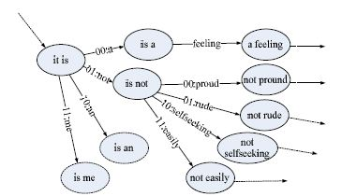
Markov Chain

Slide 9


Detect Problem 1.0
Input :
text file .
Output :
is watermarked file ?
Notes:
Te

Slide 10
Distribution of Words

Slide 14
Detect Problem 1.1

Slide 15
Support Vector Machine

Slide 16
What is SVM ?
Set of related supervised learning methods.
Analyze data and recognize patterns.
Use hyperplane and kernel Function

Slide 17



How it work ?
Class : apples <> pearls.
Attribute : weight , length .
Classifier :

Slide 18
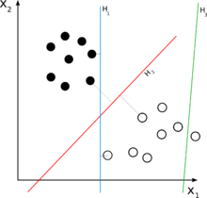
Demo

Slide 19
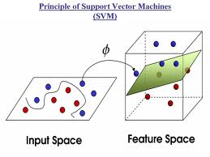
Learning Machine

Slide 20
Detect Problem 1.2

Slide 21
Train & Test

Slide 22
Data Input

Slide 23
Result Output

Slide 24
Result Output

Slide 25
Result Output

Slide 26
Result Output

Slide 27
Result Output

Slide 28
Result Output

Slide 29
Result

Slide 30
Summary

Slide 31
Demo

